Slide 1

INTERNATIONAL UNIVERSITY – VNU HCMC MIDTERM EXAMINATION (2024-2025 S2)
EN012IU SPEAKING AE2
A REAL PLACE OF STUDY
VNU CENTRAL LIBRARY
Student name: Phạm Hoàng Tuấn Tú | Student ID: ITCSIU24092
Group 01 – Test room: A2.311
Test date: 09/04/2025

Slide 2

Table Of Contents
1. Overview of the Library
2. Facilities & Resources
3. Special Features
4. Student Reviews
5. Conclusion
6. References

Slide 3
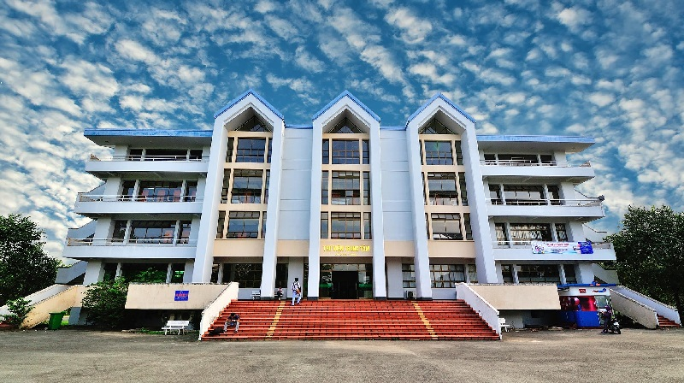
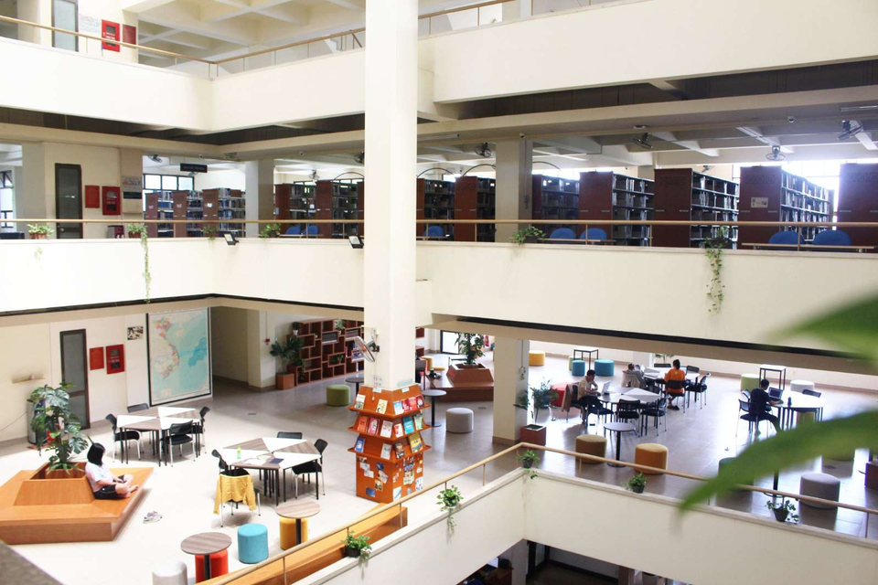
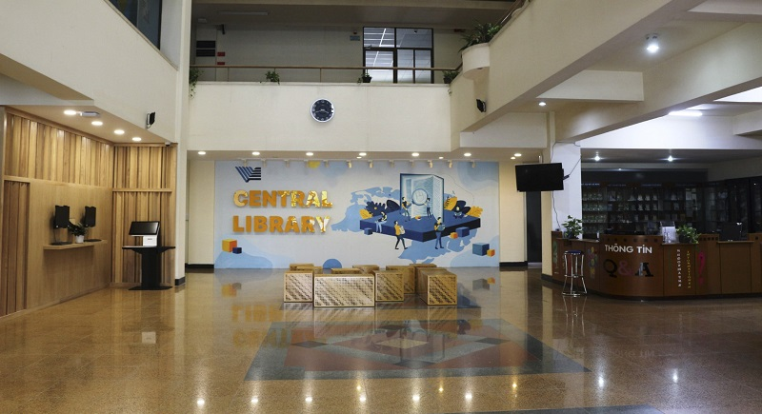
General Information
Full name: Vietnam National Central Library
Location: Linh Trung Ward, Thủ Đức City, HCMC
Part of VNU HCM system

Slide 4
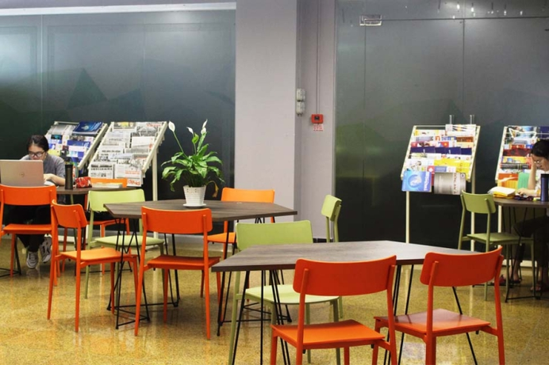

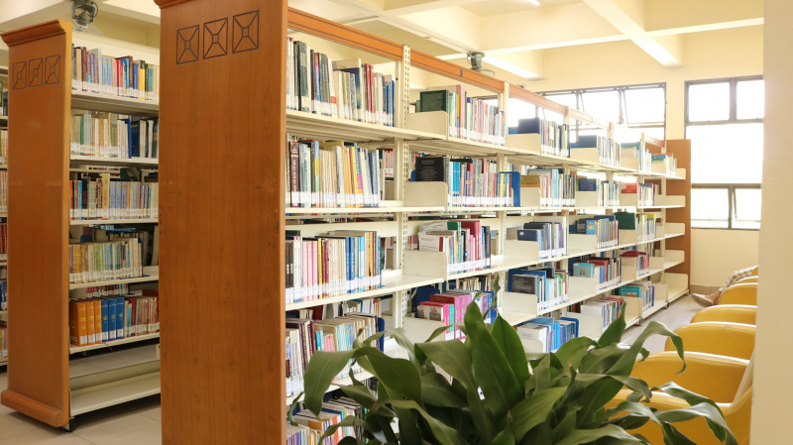
Modern Facilities & Rich Resources
Spacious reading and study areas
Computer labs and free Wi-Fi
Physical and digital books
Study rooms & collaborative spaces

Slide 5


What Makes It Special?
Open all week during exam season
Events and seminars sessions
E - Library system
Support for research and thesis writing

Slide 6
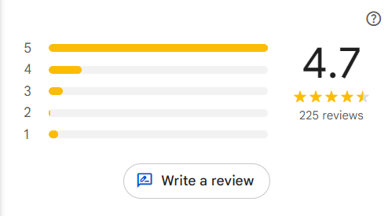
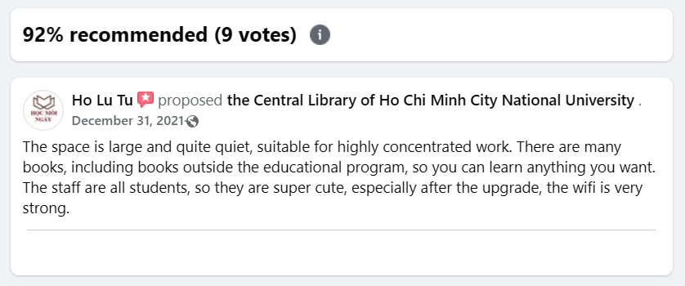
What Students Say
A peaceful and inspiring place
Very well organized with helpful staff
Cleanliness and quietness
Some wish for more group-study rooms

Slide 7
Conclusion
1. Quiet, well-equipped environment for studying
2. Access to vast academic resources
3. Helpful staff and research support

Slide 8
References
Google Map Reviews
https://tinyurl.com/vnuhcm-lib-reviews
VNUHCM CENTRAL LIBRARY FANPAGE
https://www.facebook.com/CentralLibraryVNU/?locale=vi_VN
VNUHCM CENTRAL LIBRARY WEBSITE
https://www.vnulib.edu.vn/

Slide 9
Thank you

